Slide 1
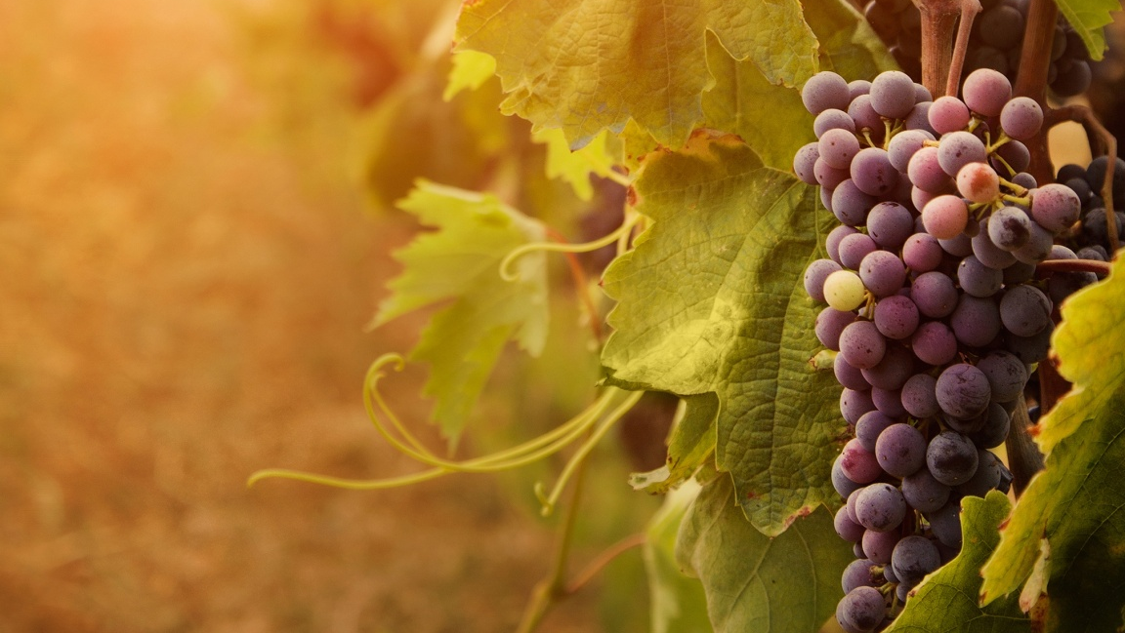
Genesis 9.18-29
mrwallpaper.com

Slide 2
Genesis 9.18-19 NET: The sons of Noah who came out of the ark were Shem, Ham, and Japheth. (Now Ham was the father of Canaan.) These were the sons of Noah, and from them the whole earth was populated.

Slide 3
Genesis 9.20-21 NET: Noah, a man of the soil, began to plant a vineyard. When he drank some of the wine, he got drunk and uncovered himself inside his tent.

Slide 4
Genesis 9.20-21 NET: Noah, a man of the soil, began to plant a vineyard. When he drank some of the wine, he got drunk and uncovered himself inside his tent.
Deuteronomy 7.13 NASB: He will love you and bless you and multiply you; He will also bless the fruit of your womb and the fruit of your ground, your grain and your new wine and your oil, the increase of your herd and the young of your flock, in the land which He swore to your forefathers to give you.

Slide 5
Genesis 9.20-21 NET: Noah, a man of the soil, began to plant a vineyard. When he drank some of the wine, he got drunk and uncovered himself inside his tent.
Matthew 26.27-29 NIV: Then he took a cup, and when he had given thanks, he gave it to them, saying, “Drink from it, all of you. This is my blood of the covenant, which is poured out for many for the forgiveness of sins. I tell you, I will not drink from this fruit of the vine from now on until that day when I drink it new with you in my Father's kingdom.”

Slide 6
Genesis 9.20-21 NET: Noah, a man of the soil, began to plant a vineyard. When he drank some of the wine, he got drunk and uncovered himself inside his tent.
1 Corinthians 5.11 NET: But now I am writing to you not to associate with anyone who calls himself a Christian who is sexually immoral, or greedy, or an idolater, or verbally abusive, or a drunkard, or a swindler. Do not even eat with such a person.

Slide 7
Genesis 9.20-21 NET: Noah, a man of the soil, began to plant a vineyard. When he drank some of the wine, he got drunk and uncovered himself inside his tent.
Ephesians 5.18 NET: And do not get drunk with wine, which is debauchery, but be filled by the Spirit.

Slide 8
Genesis 9.20-21 NET: Noah, a man of the soil, began to plant a vineyard. When he drank some of the wine, he got drunk and uncovered himself inside his tent.
Romans 13.13 NLT: Because we belong to the day, we must live decent lives for all to see. Don't participate in the darkness of wild parties and drunkenness, or in sexual promiscuity and immoral living, or in quarreling and jealousy.

Slide 9
Genesis 9.20-21 NET: Noah, a man of the soil, began to plant a vineyard. When he drank some of the wine, he got drunk and uncovered himself inside his tent.
God
Man
Family
“With the opportunity to start an ideal society, Noah was found drunk in his tent.”
--- Francisco, “The Curse on Canaan,” 648
Creation

Slide 10
Proverbs 23.29-35 NIV: Who has woe? Who has sorrow? Who has strife? Who has complaints? Who has needless bruises? Who has bloodshot eyes? Those who linger over wine, who go to sample bowls of mixed wine. Do not gaze at wine when it is red, when it sparkles in the cup, when it goes down smoothly! In the end it bites like a snake and poisons like a viper. Your eyes will see strange sights, and your mind will imagine confusing things. You will be like one sleeping on the high seas, lying on top of the rigging. “They hit me,” you will say, “but I'm not hurt! They beat me, but I don't feel it! When will I wake up so I can find another drink?”

Slide 11
Genesis 9.20-21 NET: Noah, a man of the soil, began to plant a vineyard. When he drank some of the wine, he got drunk and uncovered himself inside his tent.

Slide 12
Genesis 9.22-23 NET: Ham, the father of Canaan, saw his father's nakedness and told his two brothers who were outside. Shem and Japheth took the garment and placed it on their shoulders. Then they walked in backwards and covered up their father's nakedness. Their faces were turned the other way so they did not see their father's nakedness.

Slide 13
Genesis 9.24-25 NET: When Noah awoke from his drunken stupor he learned what his youngest son had done to him. So he said, “Cursed be Canaan! The lowest of slaves he will be to his brothers.”

Slide 14
Genesis 9.26-29 NET: He also said, “Worthy of praise is the LORD, the God of Shem! May Canaan be the slave of Shem! May God enlarge Japheth's territory and numbers! May he live in the tents of Shem and may Canaan be his slave!” After the flood Noah lived 350 years. The entire lifetime of Noah was 950 years, and then he died.

Slide 15
Genesis 9.18-29
Sermon materials available at groben.com
mrwallpaper.com

